Slide 1
Bedtime Story and welcome meeting The Meadow Primary

Slide 2
Meet the team wander around school, meet the teacher Bell rings, children go to their classroom and adults to the hall Attendance and homework updates bell rings, children are brought back to hall and hometime for bed!

Slide 3
Attendance 2024-2025

Slide 4
The Education Act 1996 states that:
All pupils of compulsory school age receive a suitable full-time education by regular attendance at school or otherwise
The Local Authority must provide school places to parents who wish their children to be educated at school
The school must complete attendance registers at the beginning of the morning session and during the afternoon session
The school must report to the Local Authority pupils who are absent for more than ten days without explanation
The Local Authority has a duty to ensure that parents fulfil their legal responsibilities
Failure by parents to ensure the regular attendance at school of a registered pupil is an offence punishable by law

Slide 5
School starts at 8.45am.
Registers are taken at 8.50am.
If your child arrives after 8.50am they will receive a late mark (L).
If your child arrives after 9.20am they will be marked as a (U) code which is unauthorised.
Each school day counts as 2 sessions – am and pm.

Slide 6
Every Day counts…

Slide 7
IS MY CHILD TOO ILL TO GO TO SCHOOL?
NHS – too ill for school…

Slide 8
High temperature
If your child has a high temperature, keep them off school until it goes away.
Coughs and colds
It's fine to send your child to school with a minor cough or common cold. But if they have a high temperature, keep them off school until it goes.
Chickenpox
If your child has chickenpox, keep them off school until all the spots have crusted over.
Conjunctivitis
You don't need to keep your child away from school if they have conjunctivitis, unless they are feeling very unwell.
Ear infection
If your child has an ear infection and a high temperature or severe earache, keep them off school until they're feeling better or their high temperature goes away
Hand, foot and mouth disease
If your child has hand, foot and mouth disease but seems well enough to go to school, there's no need to keep them off.
Impetigo
If your child has impetigo, they'll need treatment from a pharmacist or GP, often with antibiotics.
Keep them off school until all the sores have crusted over and healed, or for 48 hours after they start antibiotic treatment.
Notes:
It can be tricky deciding whether or not to keep your child off school, nursery or playgroup when they're unwell.
There are government guidelines for schools and nurseries about health protection and managing specific infectious diseases at GOV.UK. These say when children should be kept off school and when they shouldn't.
If your child is well enough to go to school but has an infection that could be passed on, such as a cold sore or head lice, let their teacher know.

Slide 9
Measles
If your child has measles, they'll need to see a GP. Call the GP surgery before you go in, as measles can spread to others easily. Keep your child off school for at least 4 days from when the rash first appears.
Ringworm/Threadworm
If your child has ringworm, see your pharmacist unless it's on their scalp, in which case you should see a GP. It's fine for your child to go to school once they have started treatment for both of these conditions.
Scarlet fever
If your child has scarlet fever, they'll need treatment with antibiotics from a GP. Otherwise they'll be infectious for 2 to 3 weeks.
Your child can go back to school 24 hours after starting antibiotics.
Slapped cheek syndrome (fifth disease)
You don't need to keep your child off school if they have slapped cheek syndrome because, once the rash appears, they're no longer infectious.
Sore throat
You can still send your child to school if they have a sore throat. But if they also have a high temperature, they should stay at home until it goes away.
Vomiting and diarrhoea
Children with diarrhoea or vomiting should stay away from school until they have not been sick or had diarrhoea for at least 2 days (48 hours).

Slide 10
Planned absence
Attending a medical or dental appointment will be counted as authorised as long as the pupil’s parent / carer notifies the school in advance of the appointment.
We encourage parents / carers to make medical and dental appointments outside of school hours where possible. Where this is not possible, the pupil should be out of school for the minimum amount of time necessary.
We may ask to see proof of appointments in order to mark them as authorised.

Slide 11
Persistent Absenteeism (PA)
A pupil is defined by the Government as a ‘persistent absentee’ when they miss 10% or more schooling across the school year for any reason; this can be authorised or unauthorised absence.
Absence at this level will cause considerable damage to any pupil’s education and we need the full support and co-operation of parents to resolve this. All pupils who have attendance levels of 90% or below are considered to be a persistent absentee.

Slide 12
Unauthorised absence and Term time holidays
Unauthorised absences are those which the school does not consider exceptional. These include but are not limited to:
Tiredness / late night
Shopping day
Minor illness and injury that does not impact on ability to learn or be in school
Pupils who arrive late after the close of the register.
Birthday celebrations
Day trips
Term time holidays
Absence for own day out instead of attending a school trip
There is no entitlement in law for pupils to take time off during the term to go on holiday. The DfE does not consider a need for a holiday to be an exceptional circumstance.
Where a term time holiday is suspected or known about, and the national threshold is met (10 sessions of unauthorised absence within a 10 week period) the school will work with the Local Authority to issue a penalty notice.

Slide 13
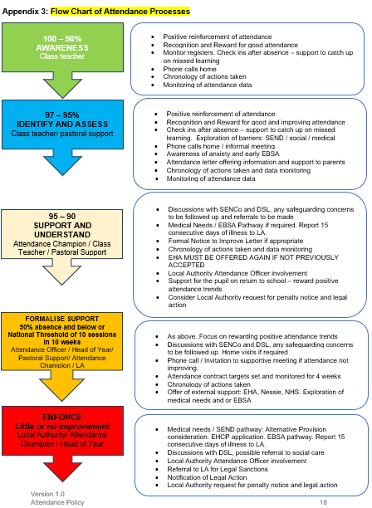

Slide 14
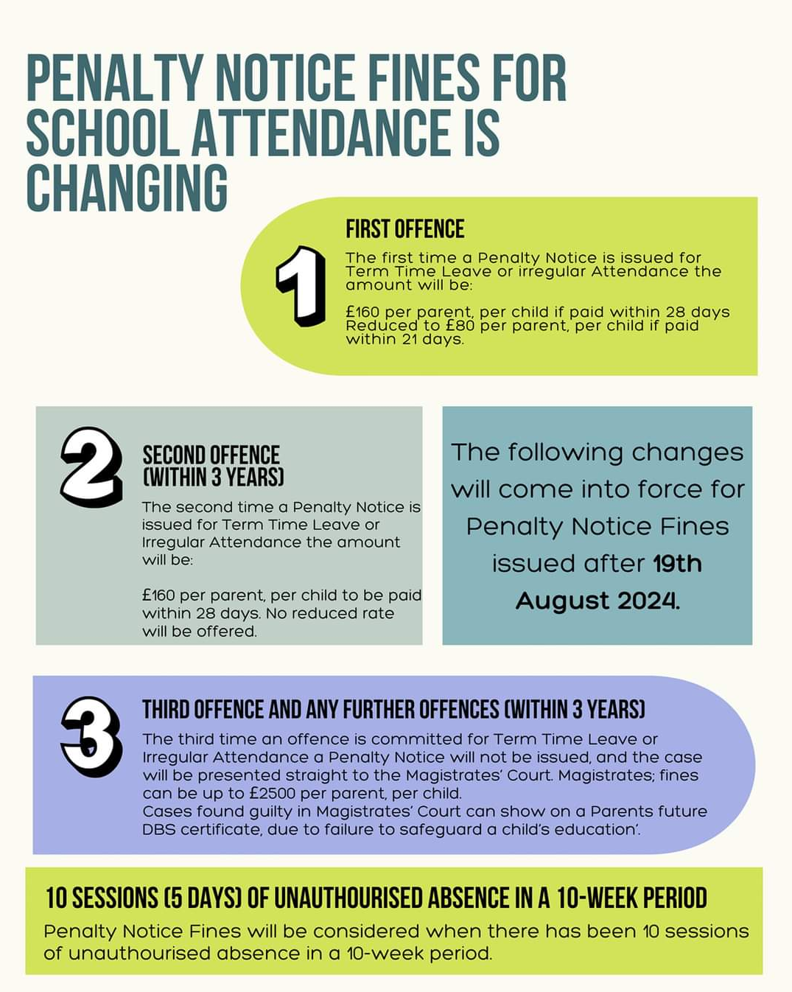

Slide 15
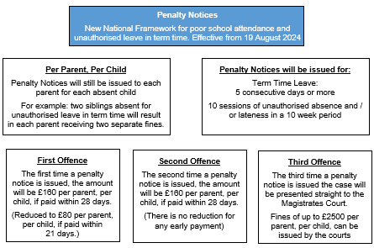

Slide 16
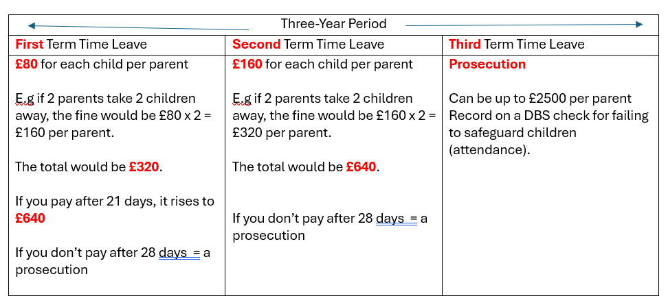

Slide 17
We are here to support – please talk to us about any attendance issues.
Staff may have to ask challenging questions about absence – please be respectful to them, they are only doing their job.
Please do not be offended if you receive an attendance letter – we have to fulfil our statutory duty
Schools do not receive any money from the penalty notices or prosecutions. We are duty bound to work with the Local Authority to process these.
We will not provide work for children on holiday.
We will happily support exceptional family events - immediate family funeral, parent/carer wedding day, parent/carer graduation day, parent/carer/sibling passing out parade or similar.
Please do not be offended if we cannot authorise your absence request, even if you deem it exceptional circumstances, we may not be able to.

Slide 18
Any Questions?

Slide 19
Homework

Slide 20
Homework We all have our opinions on homework: too much; too little; it’s a waste of time; stressful to everyone…
According to recent research (EEF), the most effective homework is work that is appropriate and of good quality. Short focused tasks which relate directly to what is being taught and which are built upon in school.
In addition, parental engagement is important.

Slide 21
Back to Basics:
Reading: Rocket Phonics books and sounds/tricky words, Recommended Read Book/ library book/Rainbow Reader
Spelling: Spelling Shed
Maths: Times Table Rockstars (from Y2) / White Rose Maths (KS1)
Additional websites: Purple Mash
Additional recommended resources: CGP books

Slide 22
Reading:
Reading daily with a parent/carer has a significant impact
on future attainment.
Reading 4 times a week can be sharing a story before bed or setting aside a time each day for reading. Reading can be: story books, non-fiction, e-books, websites, leaflets, newspapers…)
Your child will be provided with a VIPERS bookmark to support your book discussions at home.
Strategies to support reluctant readers: read a page each; set a time limit 10/15 minutes; end on a positive; encourage and celebrate achievement, however small…
Strategies to challenge readers: Use a thesaurus to find synonyms and antonyms; create their own reading comprehension questions, using the VIPER bookmark, about what they have just read and the answer these questions at the beginning of the next reading session at home…

Slide 23
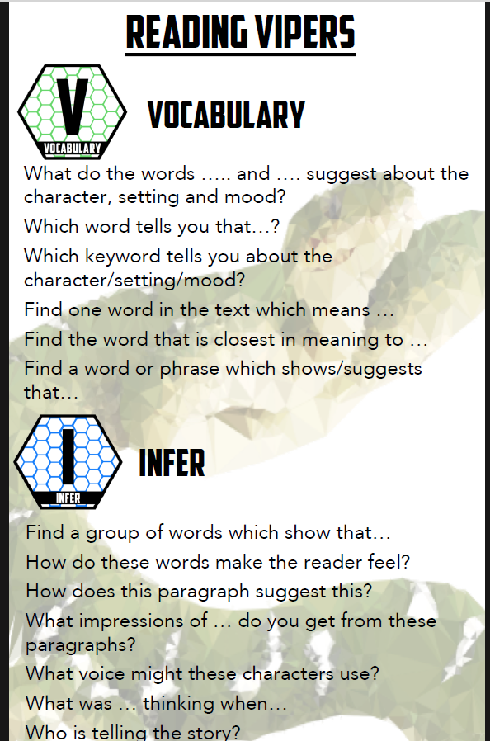
VIPERS Bookmark

Slide 24
Spelling:

Slide 25
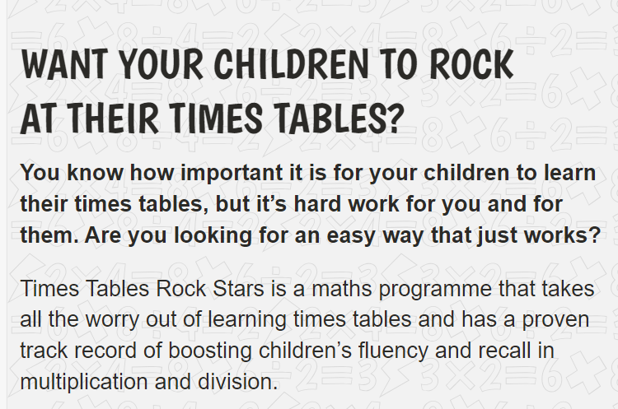
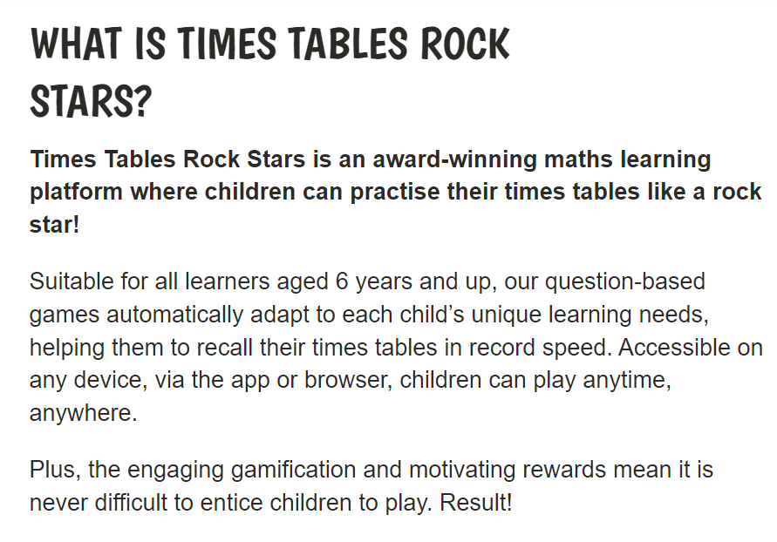
Maths:

Slide 27
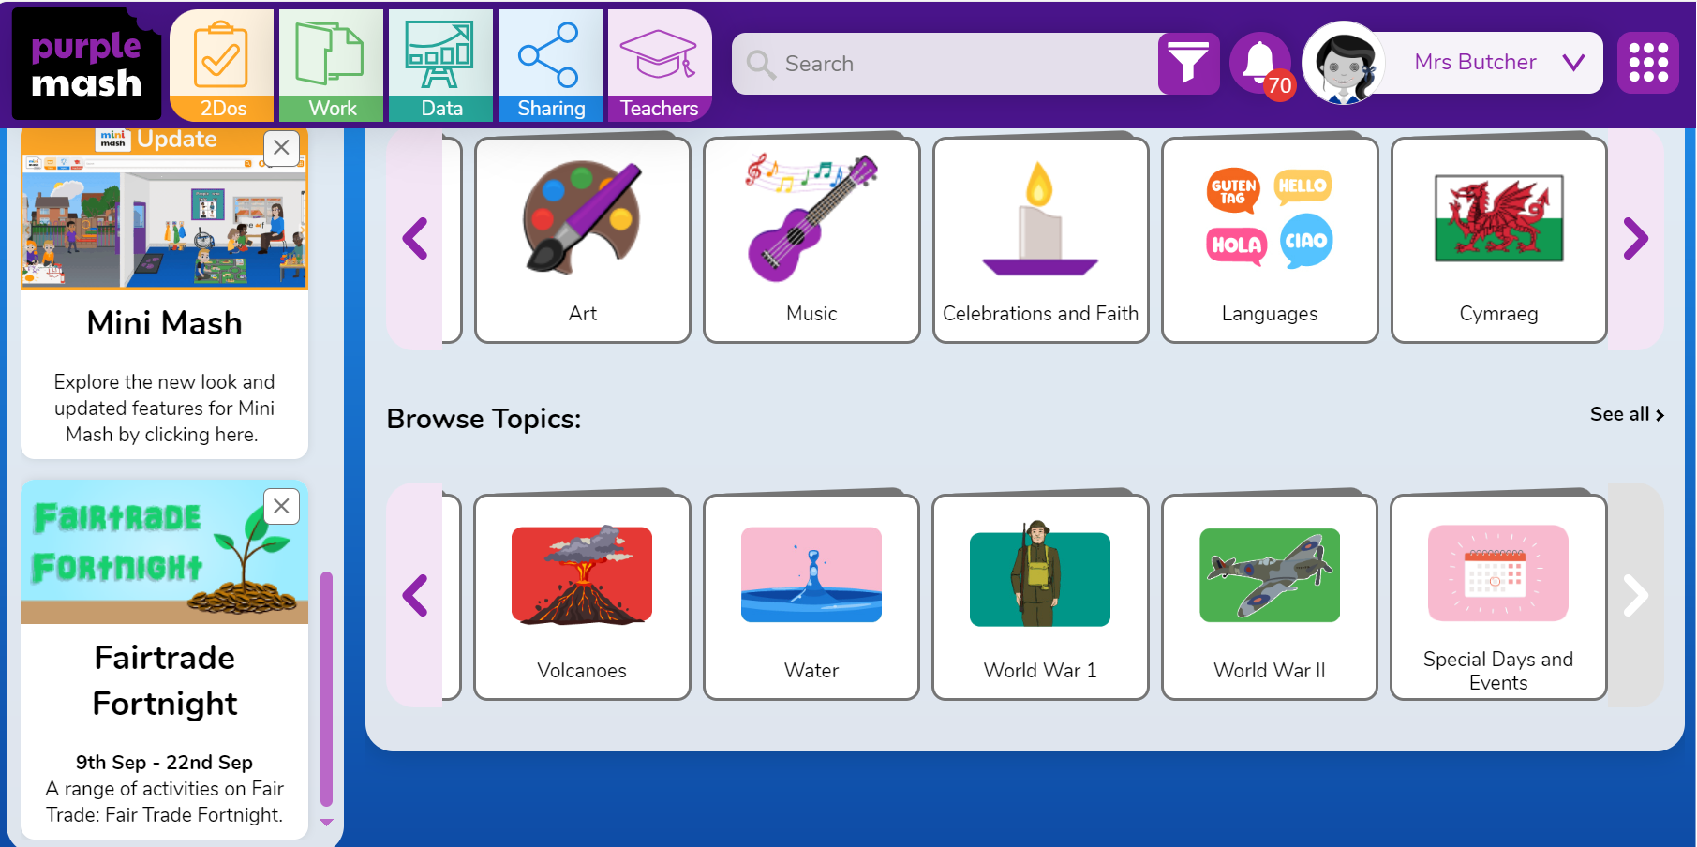

Slide 28
Paper based learning: CGP Books

Slide 29
Homework
To summarise, we hope this proposed homework will help your child to:
Learn how to organise and manage their time, developing good study habits
Take some responsibility for their own learning
Consolidate and reinforce what they have learnt in school
Inform you of their learning and offer an opportunity for you to support, encourage and be involved.

