Slide 1
Y1 Phonics at The Meadow
Rising Stars
Rocket Phonics
Faye Facer – Phonics Lead

Slide 2
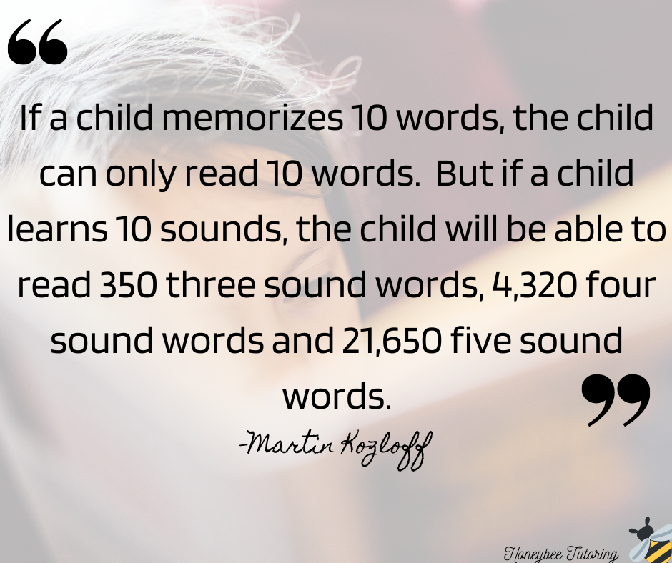
What is phonics?
Phonics is recommended as the first strategy that children should be taught in helping them learn to read.
It runs alongside other teaching methods such as Guided Reading and Shared Reading to help children develop all the other vital reading skills and hopefully give them a real love of reading.

Slide 3
What does phonics look like?
There are 6 phases which are taught from Nursery to Year 2
Phase 1 – Preschool/Reception
Phase 2 - Reception
Phase 3 - Reception
Phase 4 - Reception
Phase 5 – Year 1
Phase 6 – Year 2
• Phonics sessions take place everyday for 30 minutes.
• Children are assessed regularly and grouped accordingly to their understanding.
• We use phonics planning for the DFE approved scheme, Rocket Phonics
• Children are exposed to and encouraged to use the correct terminology i.e. phoneme, digraph , trigraph etc

Slide 4
Activity – terminology matching
Can you match the correct word to its meaning?
Notes:
Couple of minutes – get phonics screening materials ready

Slide 5
Terminology
Word | Definition
Phoneme | A single sound that can be made by one or more letters Example: s, t, ph, wh
Digraph | Two letters that make one sound Example: er, oi, ay
Trigraph | Three letters which go together to make one sound. Example: ear, air, igh
Split digraph | Two letters which work together to make one sound. These sounds are not next to one another. Example: like, name, home.
Blending | Saying the individual sounds that make up a word and then blending the sounds together to say the word orally. Example: c/a/t – cat
Segmenting | Splitting a word up into individual sounds. Example: sat – s/a/t
Grapheme | Written letters or a group of letters which represent one single sound. Example: a, b, c, d, e

Slide 6
Reminder of the importance of clear articulation
https://home.oxfordowl.co.uk/phonics-videos/#animation
https://www.risingstars-uk.com/media/Rising-Stars/Reading/Rocket-Phonics-progression-chart_1.pdf

Slide 7
Sound buttons and phoneme identification
Rain Skate
Home Spray
Hear Light

Slide 8
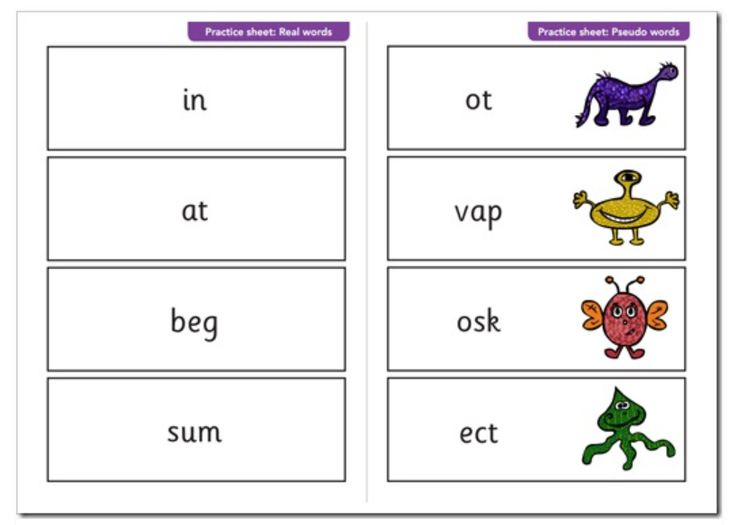
Phonics screening test
Children in Year 1 will usually take part in the phonics screening check in June.
The test will contain real
and pseudo words for the children
to read.
Notes:
Children wont be able to read by sight – need to use their phonics skills
Blarp for example – good readers struggle as they will try to make sense of a made up word.
40 words
1:1
One chance

Slide 9
Sound buttons and phoneme identification
Zorbs Jigh
Thobe Dirst
Toin Zale
Notes:
Need to report results to local authority

Slide 10
Reporting to parents
Parents will receive their child’s result and details of the pass mark in their report.
The previous pass mark has been 32/40, this is subject to change each year.
Children who do not achieve the expected level will receive extra support and retake the test in Year 2.

Slide 11
How you can help at home
Take turns to sound out a range of words, it is important to model the process.
Read as much as possible to and with your child, encouraging sounding out unfamiliar words.
If your child is struggling to decode a word, help them by encouraging them to say each sound in the word from left to right and model how to use sound buttons.
Blend the sounds by pointing to each one, e.g. /s/ in sing, /i/ sing, /ng/ in sing. Next move your finger under the whole word as you say it.
Discuss the meaning of words if your child does not know what they have read.
Help your child complete any phonic/spelling shed homework set.
Be playful with words and make it an enjoyable experience

Slide 12
Useful websites and links
https://www.phonicsplay.co.uk/
https://www.bbc.co.uk/bitesize/topics/zvq9bdm/articles/zgnrf82
https://ictgames.com/mobilePage/literacy.html
https://www.galacticphonics.com/#google_vignette
https://www.gov.uk/government/collections/national-curriculum-assessments-practice-materials

Slide 13
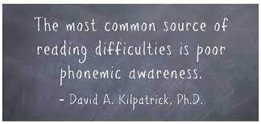
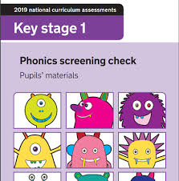
Thank you!
Any questions?

