Slide 1

No Outsiders
Parent meeting

Slide 2

Why are we using No Outsiders? What do you think it means?

Slide 3
What do we want our children to be?
Welcoming
Respectful
Kind
Inclusive

Slide 4
How do we want our children to feel?
Welcome
A sense of belonging
safe

Slide 5
This is nothing new: Our school Motto:
We Respect
We Care
We Learn
Values we follow
- tolerance - kindness
- patience - respect
-compassion - honesty
- politeness - consideration
- responsibility - perseverance
- commitment - care

Slide 6

No Outsiders gives us a language/ framework to develop what we have already.
Children understand no one is left out here because we all belong.
Our behaviour / language/ the way we treat someone can make them feel like an outsider.
Every child knows what it feels like to be left out and no one wants to be left out. Children understand the concept.

Slide 7
What does Ofsted say about inclusion? (Personal development)
whether leaders establish a suitable and coherent programme of personal development, through both the curriculum and the wider opportunities and experiences they provide for pupils
whether the school supports pupils to develop the knowledge and skills they need for participation and success in later life
whether the school promotes pupils’ wider development, character and well-being, ensuring that they receive the care and support to achieve and thrive, in school and beyond
pupils’ spiritual, moral, social and cultural (SMSC) development, which can be seen across the school’s activities

Slide 8
Inspectors focus on gathering evidence relating to the factors that statutory and non-statutory guidance, research and inspection evidence indicate contribute most strongly to personal development and well-being. (some of these relate to secondary aged pupils)
These factors are:
ensuring that the curriculum contributes to pupils’ personal development and their SMSC development
supporting pupils to become responsible, respectful and active citizens who can play their part in public life as young people and adults
developing and deepening pupils’ understanding of the fundamental British values of democracy, the rule of law, individual liberty, and mutual respect and tolerance of those with different faiths and beliefs
promoting equality of opportunity so that all pupils can thrive together and understand that individual characteristics make people unique; this includes, but is not limited to, an age-appropriate understanding of the protected characteristics defined in the Equality Act 2010
developing pupils’ character so that they reflect wisely, learn eagerly, behave with integrity and cooperate consistently well with others
developing pupils’ confidence, resilience and knowledge so that they can keep themselves mentally healthy
enabling pupils to recognise online and offline risks to their well-being – for example, risks from criminal and sexual exploitation, domestic abuse, female genital mutilation, forced marriage, substance misuse, gang activity, radicalisation and extremism – and making them aware of the support that is available
enabling pupils to recognise the dangers of using technology and social media inappropriately
developing pupils’ understanding of how to keep physically healthy, eat healthily and maintain an active lifestyle, including by providing them with enrichment activities and opportunities to be active during the school day
developing pupils’ age-appropriate understanding of healthy relationships through relationships and sex education
supporting pupils’ readiness for the next phase of education, training or employment so that they are equipped to make the transition successfully, including by providing impartial careers information, education, advice and guidance for secondary-age pupils

Slide 9

What does British law say- Equality Act 2010
Protected characteristics
Race
Religion
Sex
Gender reassignment
Age
Disability
Sexual orientation
Pregnancy or maternity
Marriage or civil partnership

Slide 10
How do we teach about this at an age-appropriate level?
KS1- talk about difference – what does it mean, look like, feel like
KS2- build on that knowledge to talk about British law and the protected characteristics
Use picture books with stories about difference, acceptance, respect
Use assemblies that talk about real life stories showing difference, acceptance and respect around the world
Develop a common language in school where difference is understood and accepted –there are no outsiders here.

Slide 11
Celebrate / tolerate/ accept/ embrace
We don’t need to “celebrate” any differences; we embrace difference at our school and teach children that difference is a part of our lives.
We live in a multicultural society and children are going to experience different people as they grow up. We want our children to be prepared for life in modern Britain.
No One is pushed out, invisible, no one is an outsider here. We want children to be proud of the person they are, proud of their family, proud of their heritage. And we want children to listen to each other and learn.

Slide 12
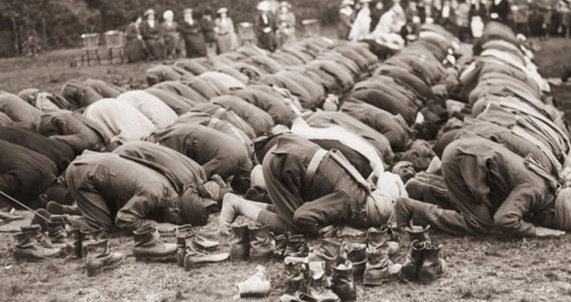
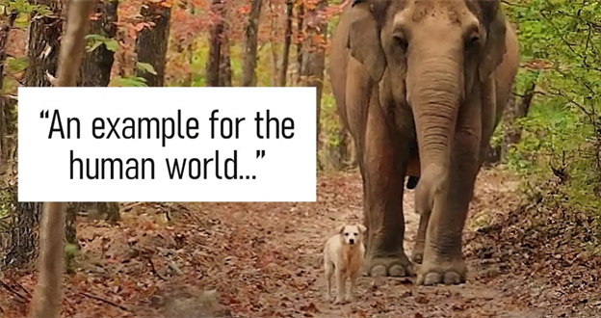
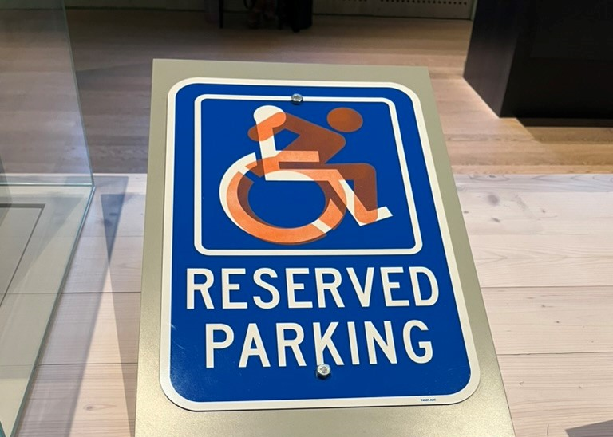
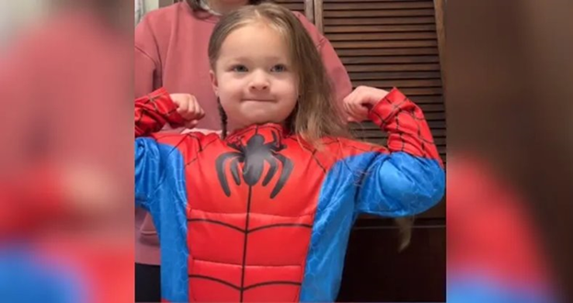

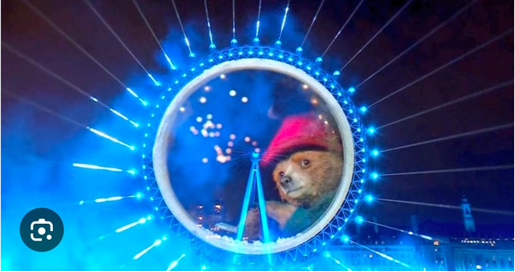
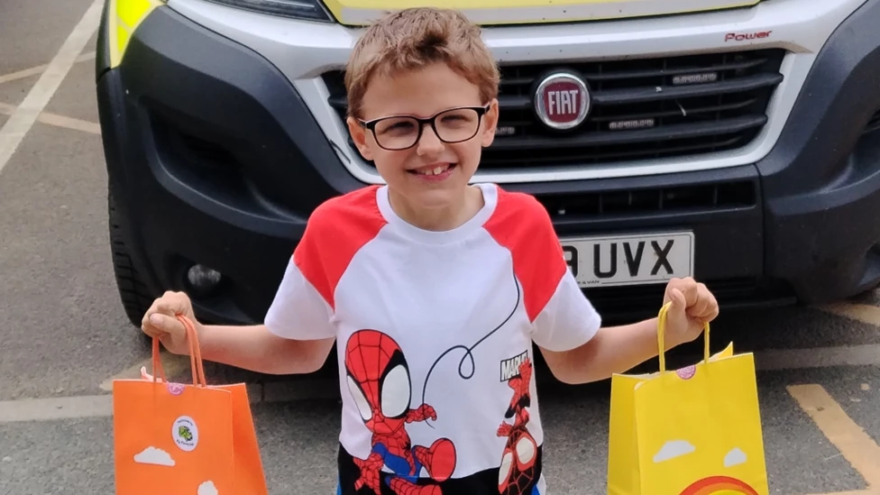
Here are examples of No Outsiders assemblies.
The assemblies use current news stories to make No Outsiders real so children can share opinions, agree and disagree. There is no right or wrong answer in a no outsiders assembly.
We will share assembly themes we use so you know what we are talking about in school and can continue the discussion at home, giving your view.

Slide 13
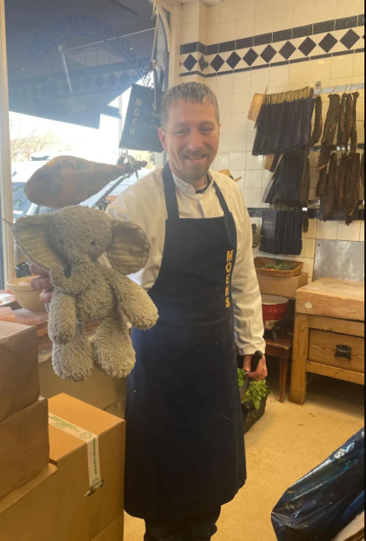
What do you see here? who do you think this is? what is their jo? There are clues in the picture to show what job they have. They are holding two things; one is about their job, the other is about the story here - which is which?
This is Matt Smith, he is a butcher living in Clapham, London.
What is a butcher, what does a butcher do? Which objects in the photo tells us Matt is a butcher?
Why do you think Matt is holding a toy elephant?
The elephant belongs to a three year old boy and it is his pride and joy.
What does "his pride and joy" mean "?
The boy dropped the elephant on a zebra crossing and didn't realise he had lost it till he got home.
The boy's mum, Catherine, went out to search for the elephant but not find it. She posted a picture of the elephant online to ask if anyone has seen it.
Matt had already found the elephant on the zebra crossing earlier that day and he put it in his shop window.
Why didn't Matt leave the toy in the road?
Why put it in his shop window do you think Matt wanted to sell it?
Catherine, the boy's mum, thought they would never see the elephant again and lost hope. Her little boy went to bed in tears that night.
But people shared the photo of the elephant online asking if anyone had see it... what do you think happened next?
A customer in Matt's butcher shop had seen the photo online and recognised the elephant in Matt's shop window. She showed Matt the photo and Matt contacted Catherine online to say he had the elephant and she cold come and get it.
How do you think Catherine felt? (any other words than happy?)
Matt says, "It's a close knit community round here."
Catherine added, "For me, I'm, all about community, it's why we moved here... This situation would never happen anywhere else- it's a testament to Clapham and the people here."
What is a community?
What does 'close knit community' mean?
"This situation would never happen anywhere else," Do you agree, or disagree with Catherine? Could this story only happen in Clapham?
Could this story happen here we live? Do we have a community here? Can anyone think of an example of community in or around our school?
In a community is everyone the same or is everyone different?
How are people different in our community?
Why is this about No Outsiders?
Which British Value is this about?

Slide 14
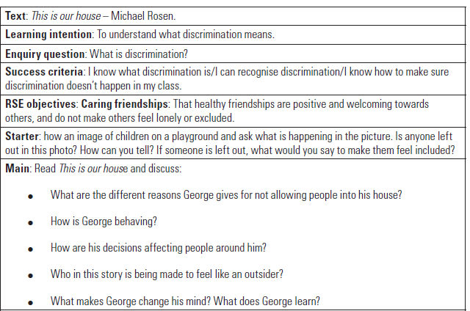
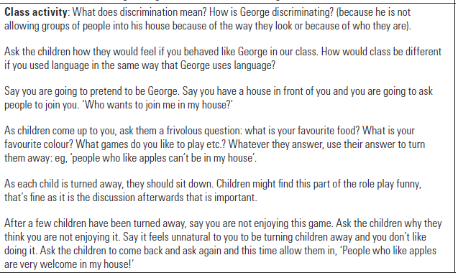
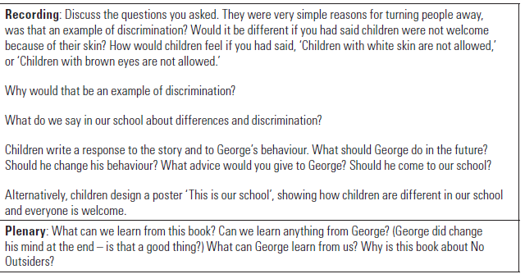

Slide 15
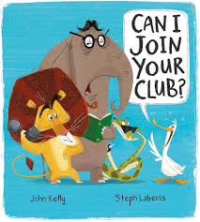
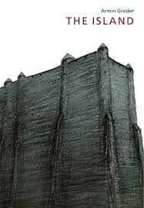








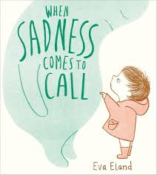



Please look at the books and let us know what you think

Slide 16
What next…
Staff will continue to have training to deliver effectively
Reassurance of we are not telling children what to think or indoctrinate them. We are focussing upon the equality act and the topics we currently cover within PSHE lessons.
We will plan when we are delivering each lesson each half term
Weekly assemblies will be delivered (these build from our book assemblies last year)
Parent/Carer booklet available - we will email this out and upload to the website.
Parent/Carer sessions through the year to answer questions – dates to follow
An openness of communication if you have concerns

