Slide 1

Phonics at The Meadow
Rising Stars
Rocket Phonics
Faye Facer – Phonics Lead

Slide 2
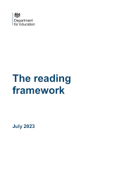
First of all: The importance of reading
Why reading matters
Building a love of reading, pleasure for reading
Strengthening relationships
Improves concentration
Builds neural pathways
Helps you gain further information
Encourage creativity
Develops empathy
Teaches children about language

Slide 3
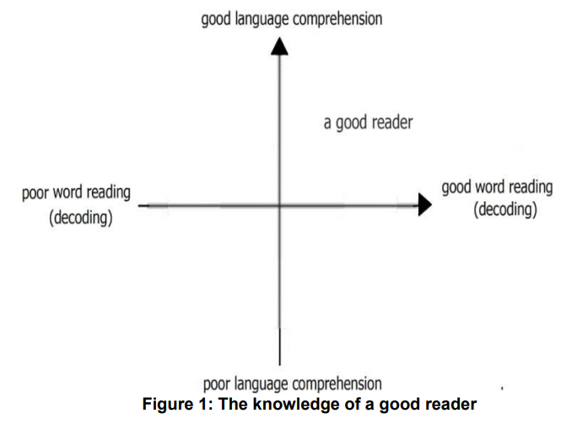
Language comprehension
Comprehension does not refer to reading itself but, rather, to the way in which we make sense of words, sentences and the wider language we hear or read.
Children need both good language comprehension and good word reading to become good readers.
Notes:
Simple view of reading

Slide 4
Developing talk
Language
A language-rich environment is one in which adults talk with children throughout the day. The more children take part in conversations and discussion, the more they will understand once they can read and the more vocabulary and ideas they will have to draw on when they can write.
Listening
We need to teach children how to listen. Model being a good listener and praise when they have demonstrated this.
Poetry and rhymes
The predictability of rhymes in poems and songs also helps children to memorise and reuse newly acquired words and phrases. Learning poems including traditional nursery rhymes such as ‘Hickory Dickory Dock’, ‘Little Jack Horner’ and ‘Baa Baa Black Sheep’ can also heighten children’s awareness of the individual sounds within words through alliteration, assonance and rhyme. For instance, because rhymes share the same end sound, they alert children to the contrast of the phonemes at the start of each word, as well as the repeated phonemes at the end, as in ‘dock’/ ‘clock’, ‘Horner’/‘corner’ and ‘Incy’/‘Wincy’
Notes:
‘Wait a minute, I need to listen carefully.’
‘Let’s be quiet so I can concentrate on what you’re saying.’
‘I could tell you were going to say something interesting: I could see you were listening carefully and concentrating.’
Learning poetry and songs using ‘call and response’ allows children to join in gradually. Each repetition strengthens their vocabulary, embedding new words.

Slide 5
Word reading and spelling
This is where phonics comes in!
Decoding (word reading) and encoding (spelling)
Phonemes
Words are made up from small units of sound called phonemes. Phonics teaches children to be able to listen carefully and identify the phonemes that make up each word. This helps children to learn to read words and to spell words
In phonics lessons children are taught three main things:
Grapheme phoneme correspondences (GPCs)
Blending
Segmenting

Slide 6
GPCs
Children are taught GPCs. This stands for grapheme phoneme correspondences. This simply means that they are taught all the phonemes in the English language and ways of writing them down. These sounds are taught in a particular order.
The first sounds to be taught are s, a, t, i, p.

Slide 7
Blending
Children are taught to be able to blend. This is when children say the sounds that make up a word and are able to merge the sounds together until they can hear what the word is. This skill is vital in learning to read.
/b/ /e/ /d/ = bed
/t/ /i/ /n/ = tin
/m/ /u/ /g/ = mug

Slide 8
Segmenting (chopping up)
Children are also taught to segment. This is the opposite of blending. Children are able to say a word and then break it up into the phonemes that make it up. This skill is vital in being able to spell words.
bed = /b/ /e/ /d/
tin = /t/ /i/ /n/
mug = /m/ /u/ /g

Slide 9
Daily phonics
Every day the children have a 30 minute session of phonics.
• The lessons incorporate opportunities for children to:
- revisit and review previous learning
learn something new
practise that new learning and
apply it.
Lessons encompass a range of oral rehearsal, stories, games, physical activity, matching, sorting,

Slide 10
Phonics words
Your children will learn to use the term:
phoneme - Phonemes are sounds that can be heard in words e.g. c-a-t
grapheme - This is how a phoneme is written down e.g. goat
digraph - This means that the phoneme comprises of two letters e.g. ll, ff, ck, ss
trigraph - This means that the phoneme comprises of three letters e.g. igh , ear, air

Slide 11
Saying the sounds
Sounds should be articulated clearly and precisely.
Have a go at pronouncing these phonemes:
a p l b h ai ur ph ie
https://www.youtube.com/watch?v=BqhXUW_v-1s
https://home.oxfordowl.co.uk/phonics-videos/#animation

Slide 12
Progression of teaching
https://www.risingstars-uk.com/media/Rising-Stars/Reading/Rocket-Phonics-progression-chart_1.pdf
Children will use the phonemes to read and spell simple “consonant-vowel-consonant” (CVC) words:
sat, tap, dig, duck, corn, puff, sail, dark, sheep
All these words contain 3 phonemes.
Notes:
Log shark kiss light

Slide 13
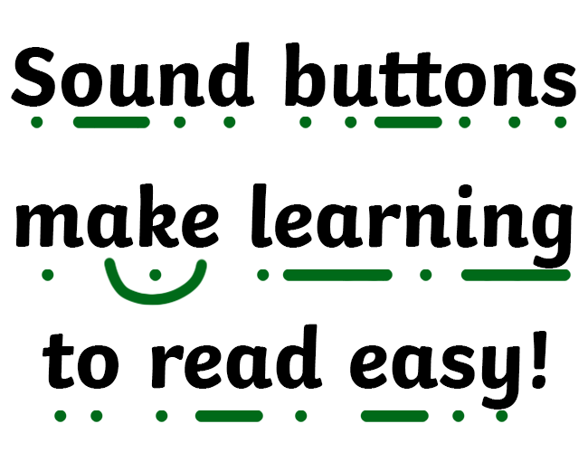
Sound buttons
beach
squawk
puffin
drive
flashlight
parallelogram
Notes:
Log shark kiss light

Slide 14
Tricky words
There are many words that cannot be blended or segmented because they are irregular.
the was said you some

Slide 15
Early Learning Goal
Word Reading
Say a sound for each letter in the alphabet and at least 10 digraphs.
• Read words consistent with their phonic knowledge by sound-blending.
• Read aloud simple sentences and books that are consistent with their phonic knowledge, including some common exception words.

Slide 16
Early Learning Goal
Comprehension
Demonstrate understanding of what has been read to them by retelling stories and narratives using their own words and recently introduced vocabulary.
Anticipate (where appropriate) key events in stories.
Use and understand recently introduced vocabulary during discussions about stories, nonfiction, rhymes and poems and during role play.

Slide 17
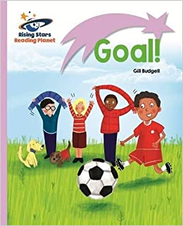


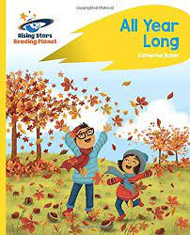

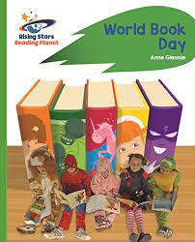
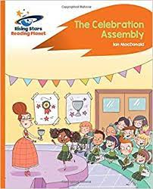
Books your child will be sent home with…

Slide 18
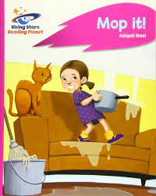


‘Decodable’ books and texts for children to read
‘Decodable’ books and other texts make children feel successful from the very beginning. They do not encounter words that include GPCs they have not been taught. If an adult is not present, they are not forced to guess from pictures, the context, the first letters of a word or its shape
‘Decodable’ books and texts that children read should run alongside or a little behind the teaching of the GPCs, so that they always feel a sense of achievement when they are asked to read such books. It is important that children practise their reading with ‘decodable’ books or texts.
Notes:
They speed up the time they need to gain sufficient accuracy to read a wide range of children’s literature. It is helpful, therefore, if teachers explain to families how they can help their children to read such books when they bring them home.

Slide 19
Early Learning Goal
Writing
• Write recognisable letters, most of which are correctly formed.
• Spell words by identifying sounds in them and representing the sounds with a letter or letters.
• Write simple phrases and sentences that can be read by others.

Slide 20
How can you help at home?
Talk to your children! Model talking and listening.
Read everyday with your child.
Ask questions about the story. What is the story about? What is your favourite part? Why?
Use the front and back cover to scaffold your questioning and book talk
Practise the phonemes sent home – make words out of them
‘Chop up’ words. Model segmenting words for your child to blend “Let’s get the b-u-s” What’s in the box? is a good game for this
Help your child learn the tricky words. Stick them everywhere!
Point to a tricky word and ask them what it is.
Social Media

Slide 21
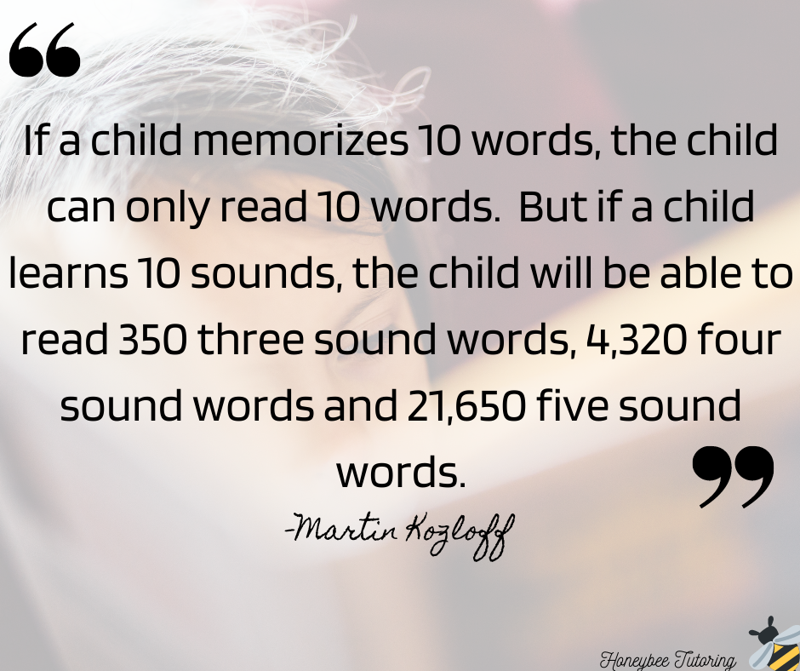
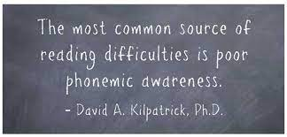

Thank you for taking the time to come today.
Your support will make a real difference in your child’s phonics journey and overall learning.

Slide 22
# | Account | Handle / Platform | What they share / focus
1 | Five Minute Mum | @fiveminutemum (Insta / FB) | Quick phonics & literacy tips, “5 minute” activities for busy parents
2 | The Phonics Fairy | @thephonicsfairy | Phonics explained for parents, mini‑lessons, tips & support Linktree
3 | Phonics is Fun™ | via Linktree / Instagram | Fun phonics activity ideas & free resources Linktree
4 | Fabulous at Phonics | via Linktree / Instagram / TikTok | Literacy consultant sharing playful phonics ideas & parent support Linktree
5 | Reading Roots | @readingroots.uk | Posts aimed at teaching phonics to parents, resources, guidance HypeAuditor.com
6 | Fun With Phonics (Herts) | @funwithphonicsherts | Local phonics ideas, visuals, tips for home practice Miss Phonics
7 | UK Little Readers | @uklittlereaders | Phonics / reading tip posts for young learners Linktree
8 | Nu:Phonics | via Linktree / Instagram | Phonics support materials & parent guidance Linktree
9 | Phun Phonics & Magic Maths | @phunphonics_and_magicmaths | Phonics + math crossover, creative strategies for learning schoolofinfluence.co.uk
10 | The Little Reading Nest | via website / social | Early reading, writing, phonics support with practical ideas for parents thelittlereadingnest.co.uk
✅ Good social media / online accounts & resources

Slide 23
https://www.myteachingcupboard.com/blog/effective-strategies-for-teaching-phonemic-awareness

