Slide 1
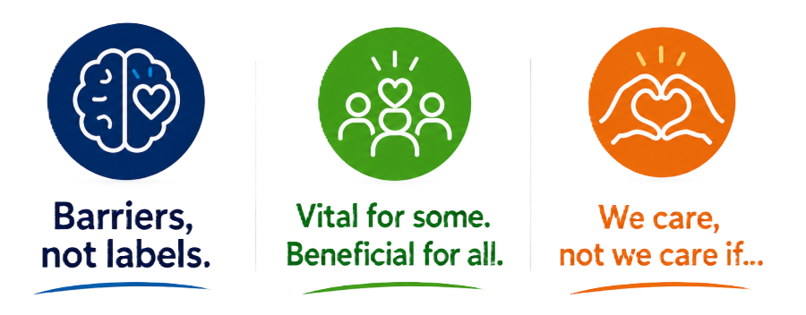
1
Notes:
“Yesterday we introduced three ideas that I want to become part of how we think across our schools. They aren't three separate initiatives. They're three ways of looking at the same question: what do the children in front of us need from us?”

Slide 2
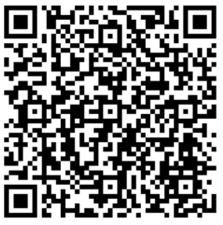
What matters most to you for your child?
1

Slide 3
Children don't arrive at learning in the same state every day.
Neither do we
2
Notes:
“Children can arrive excited, tired, anxious, angry, worried, overwhelmed, distracted, settled or completely ready to go. Their state changes during the day too — after play, after a disagreement, when work becomes difficult, when something unexpected happens.
And that's normal.
So if we want children to become the things we've just described, we need some shared understanding of what happens when emotion becomes powerful — and what helps us get our thinking back online.”

Slide 4
Why?
Why can we know the right thing to do… and still react differently?
2
Notes:
“To help our children understand this — and to help us understand it too — we're going to use a really simple model throughout our wellbeing work.”

Slide 5
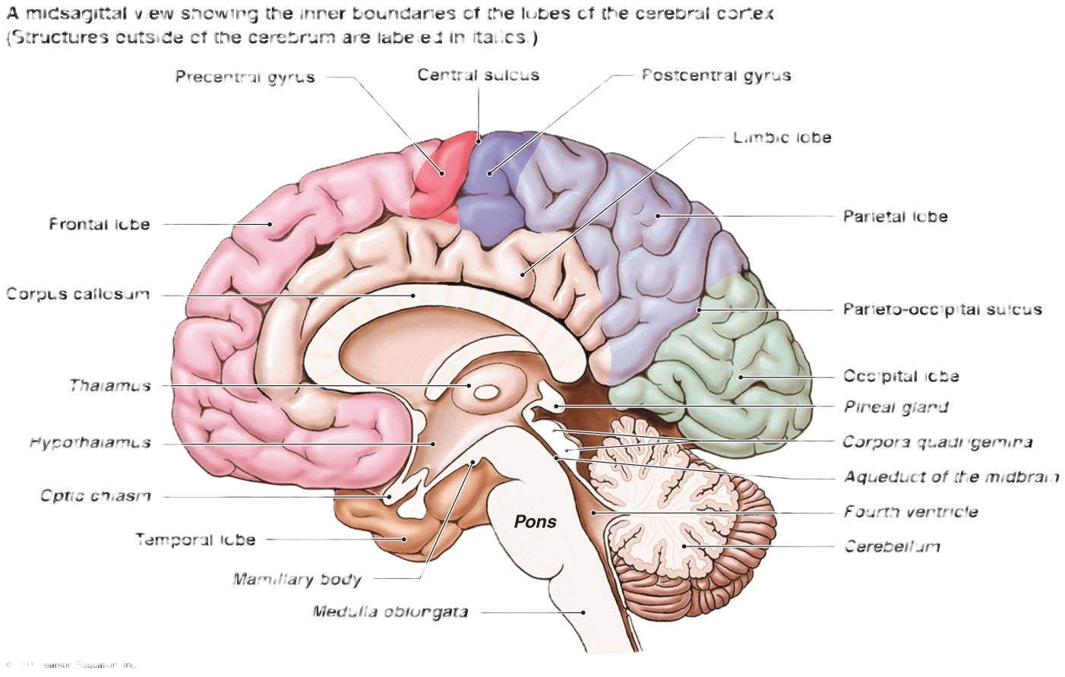
The Brain
2
Notes:
“To help our children understand this — and to help us understand it too — we're going to use a really simple model throughout our wellbeing work.”

Slide 6
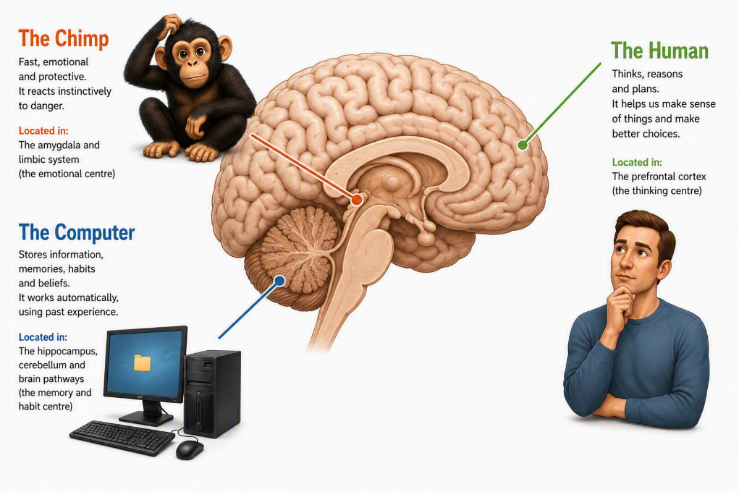
The Chimp Paradox
2
Notes:
“To help our children understand this — and to help us understand it too — we're going to use a really simple model throughout our wellbeing work.”

Slide 7
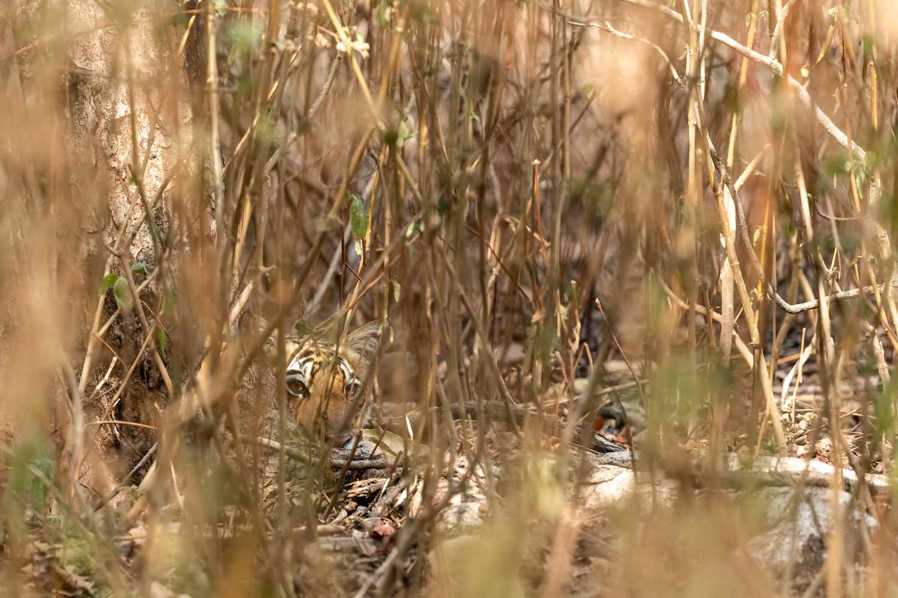
Go back thousands of years…
Imagine survival depends on noticing danger quickly.
DANGER
ACT NOW
Notes:
To understand the Chimp's job, we're going to go back thousands of years.
Imagine genuine danger can appear quickly. You hear something moving nearby. You don't have five minutes to gather evidence and carefully weigh every possibility.
You need to notice danger and act.
This is a story to introduce Steve Peters' model, not a literal evolutionary diagram of the brain.

Slide 8
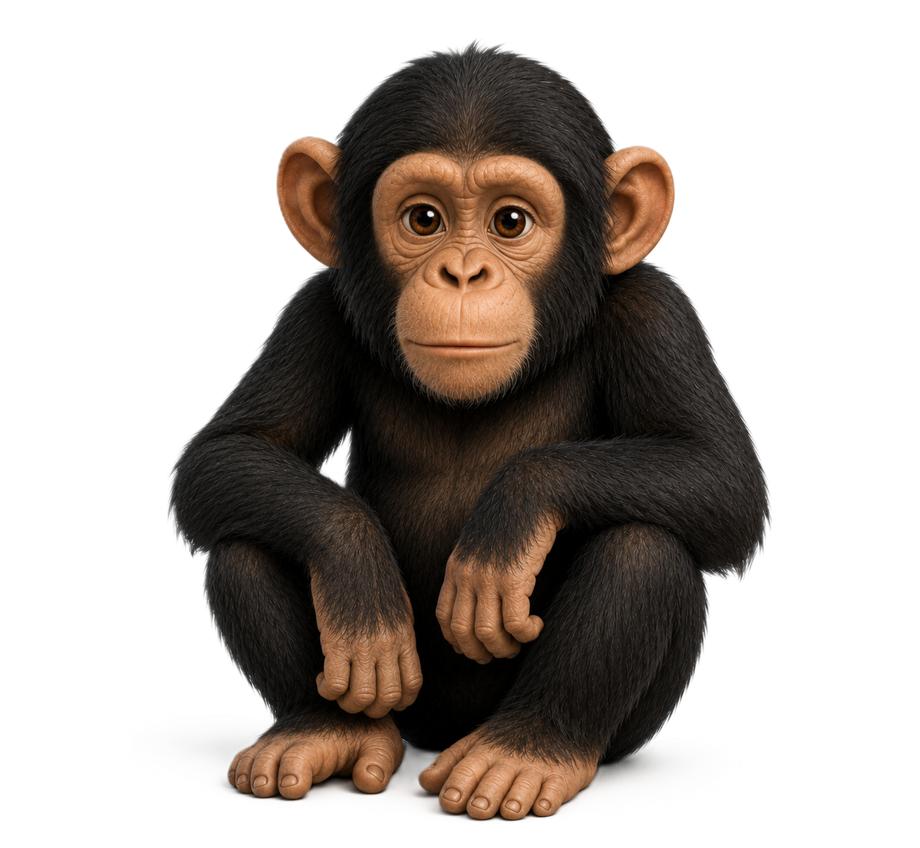
Your Chimp has one very important job.
KEEP YOU SAFE.
Notice danger → react quickly → protect
The Chimp isn't bad. We need it.
Notes:
In Peters' model, the Chimp represents fast, emotional, protective responses. Its priority isn't producing the most thoughtful answer; its priority is protection.
The Chimp isn't bad. We need fast protective responses.
Be explicit: this is a useful model/metaphor, not a literal anatomical map.

Slide 9
Fast can be useful.
When something genuinely feels dangerous, rapid protective responses make sense.
FIGHT
FLIGHT
FREEZE
Notes:
If there really is danger, stopping to think for five minutes isn't particularly helpful.
Keep fight/flight/freeze as familiar shorthand rather than a detailed neuroscience claim.
Then: But here's the interesting bit…

Slide 10
What ‘dangers’ were there 100,000 years ago?
Other people
Injury
Excluded from the tribe
Animals
Illness
Notes:
None of these is a tiger, but to a child the experience can still carry a strong emotional load.
Threat can relate to safety, uncertainty, belonging, relationships, competence, embarrassment or feeling out of control.

Slide 11
What ‘dangers’ do children face in school?
“Everyone is looking at me.”
“I don't know what to do.”
“I've got it wrong.”
“That's not fair.”
“My friend doesn't want me.”
“The plan has changed.”
“This is too hard.”
“I'm going to fail.”
Notes:
None of these is a tiger, but to a child the experience can still carry a strong emotional load.
Threat can relate to safety, uncertainty, belonging, relationships, competence, embarrassment or feeling out of control.

Slide 12
How does the chimp react/behave?
FEELS THREATENED → PROTECT
Behaviour is the visible part. It doesn't tell us the whole story.
Notes:
Sometimes what we experience as difficult behaviour may be a child's attempt to manage something that feels difficult to them.
That doesn't make unsafe or harmful behaviour okay. Understanding what may be driving it gives us a better chance of helping the child learn a different response.
This sets up Roots & Fruits later.

Slide 13
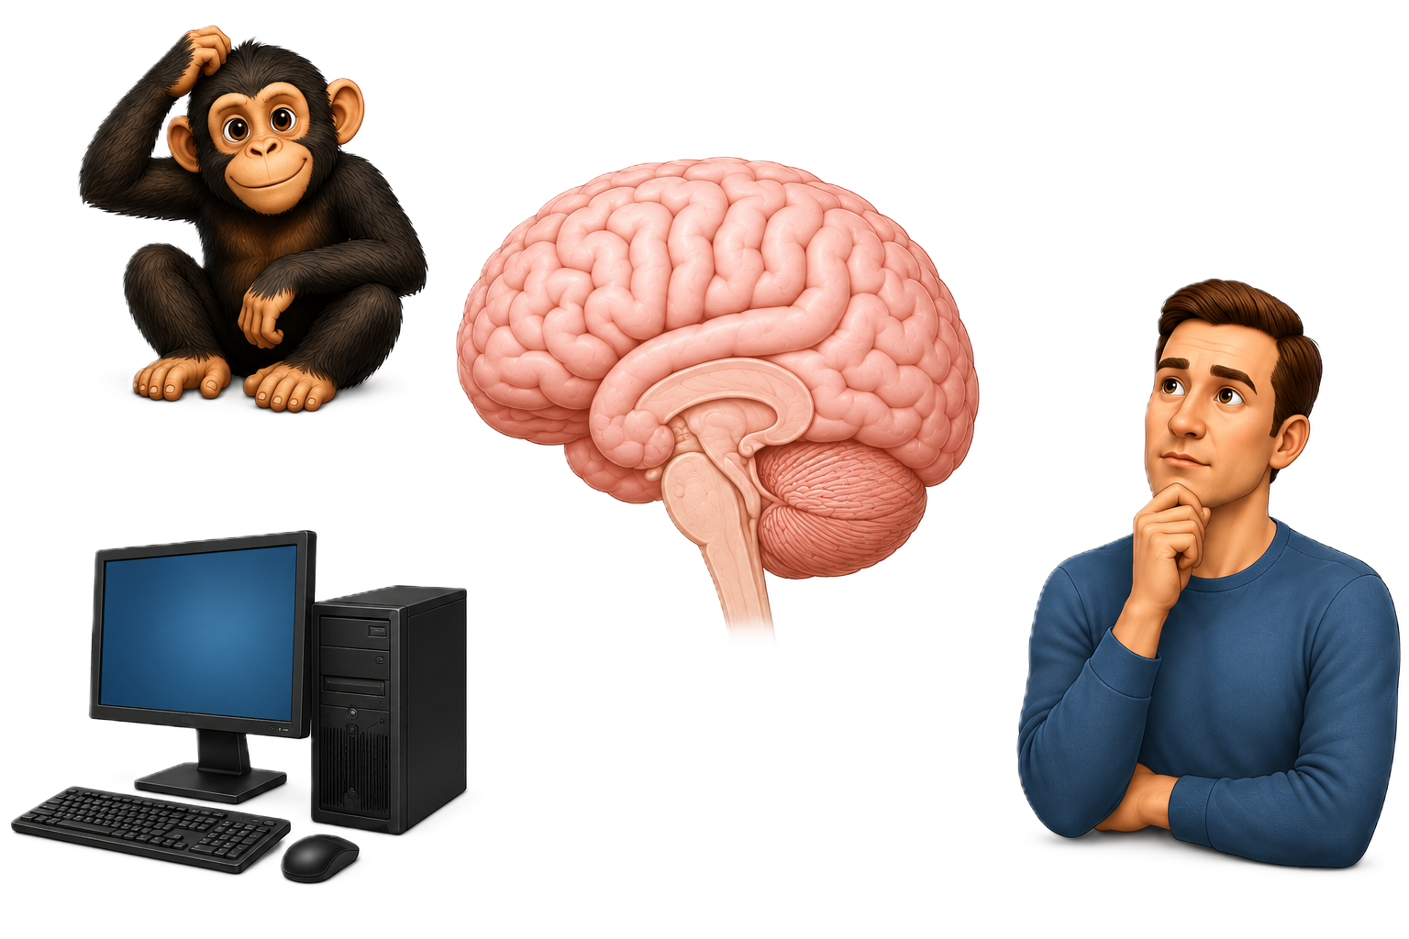
But the Chimp isn't the whole model.
Notes:
Now introduce the Human.
Peters uses the Human to represent more deliberate, reflective thinking: pausing, reasoning, considering consequences, planning and choosing.
This is the sort of thinking we ask children to use all day in school.
Again, this is a model, not a literal brain region.

Slide 14
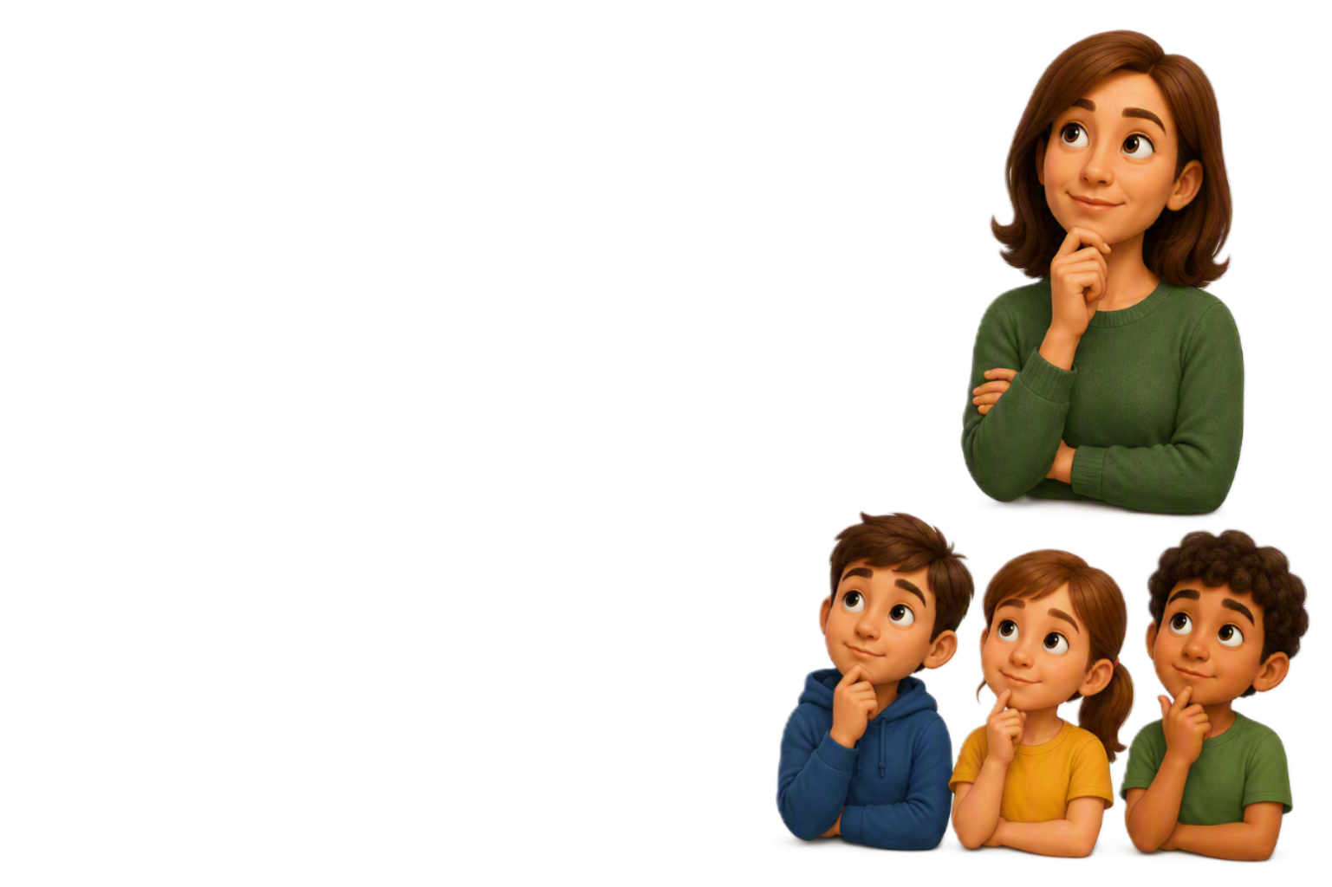
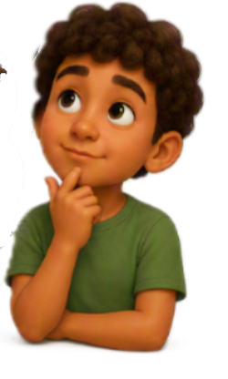
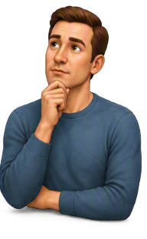
Meet the Human.
Pause • think • reason • plan • consider • choose
What sort of people do you want to be?
Notes:
Now introduce the Human.
Peters uses the Human to represent more deliberate, reflective thinking: pausing, reasoning, considering consequences, planning and choosing.
This is the sort of thinking we ask children to use all day in school.
Again, this is a model, not a literal brain region.

Slide 15
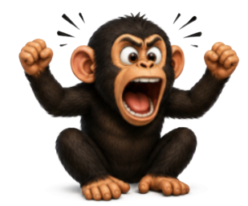
Chimp and Human can want different things.
CHIMP
HUMAN
“Get me out of this.”
“This is unfair.”
“Do something NOW.”
“Pause.”
“Let's work this out.”
“What could I do next?”
Notes:
Make this relatable rather than child-focused.
We can know the sensible thing to do and still feel a powerful urge to react differently. That's part of why the model can be useful as shared language for adults and children.

Slide 16
The Computer
Stores experiences and memories
Stores beliefs and expectations
Stores learned behaviours and habits
Creates automatic responses
Works without us consciously thinking
Can react faster than the Chimp or Human
Can contain helpful and unhelpful programmes
Can be reprogrammed through new experiences and practice
Notes:
“The really important thing about the Computer is speed. Peters describes it as the fastest part of the system. If it already has a programme for this situation, it doesn't need to stop and work things out. It can respond automatically. In the model, it can act before the Chimp has even had time to react.”

Slide 17
What's stored in the Computer?
EXPERIENCES
What has happened to me before?
BELIEFS
What have I learned about myself, other people and the world?
EXPECTATIONS
What do I think is going to happen?
LEARNED RESPONSES
What have I learned to do when this happens?
HABITS
What have I practised so often that it becomes automatic?
The Computer is constantly being programmed by experience and practice.
Notes:
The Computer is constantly being programmed by what we experience and what we practise. Some of what gets stored is useful. Some of it isn't.

Slide 18
Not everything stored is helpful.
HELPFUL
UNHELPFUL
“I can ask for help.”
“I'm rubbish at this.”
“Getting it wrong is embarrassing.”
“Mistakes are part of learning.”
“Adults always tell me off.”
“Adults will help me.”
“Once it's gone wrong, it's ruined.”
“I can recover.”
“I know what to do when I'm frustrated.”
“When I'm angry, I shout.”
But what's stored isn't fixed.
Notes:
Stored beliefs and responses can be helpful or unhelpful. These are examples, not diagnostic statements. The hopeful part is that stored learning is not fixed.

Slide 19
“Can I have a word?”
What's just happened in your head?
Notes:
Imagine at the end of today someone catches you on the way out and says, 'Can I have a word?' Pause. Ask staff what just happened in their head before anything has actually happened.

Slide 20
Same words. Different Computers & Chimps
“Can I have a word?”
“What have I done?”
“I'm in trouble.”
“I wonder what they want?”
“This won't be good.”
“Maybe they need my help.”
“Great — perhaps it's about that idea.”
Nothing has happened yet — but something stored may already be influencing the response.
Notes:
Why didn't everybody's brain give exactly the same response? Because we do not have the same things stored: different experiences, beliefs and expectations.

Slide 21
Now imagine you're 8.
“We're doing some independent writing.”
“I always get this wrong.”
“I can do this.”
“Everyone else finishes before me.”
“I can ask for help.”
“People notice when I get it wrong.”
“Mistakes are okay.”
“I need to get out of this.”
“My teacher will help me.”
Same instruction. Different stored learning.
Notes:
Same classroom, same teacher, same instruction — potentially a completely different emotional response because children are not arriving with the same stored experiences.

Slide 22
The Computer can be reprogrammed.
Not simply by telling a child to think differently.
NEW EXPERIENCES
+
REPEATED PRACTICE
Notes:
Use 'reprogrammed' as part of Peters' Computer metaphor, not as a literal neuroscience claim. We do not erase a belief by contradicting it; new learning usually needs new experience and repeated practice.

Slide 23
Reprogramming takes experience.
OLD PROGRAMME
NEW EXPERIENCES
Difficult work
Difficult work
↓
↓
Adult notices and supports
“I can't do this.”
↓
↓
Practise asking for help
Avoid / refuse
↓
↓
Experiences success
Another difficult experience
↓
REPEAT
Over time: “I can ask for help.” • “Adults will help me.” • “I can get through this.”
Notes:
A new programme is built through repeated successful experiences. This is why consistency and practice matter.

Slide 24
If we want it stored, children need opportunities to practise it.
Ask for help
Cope with mistakes
Notice how they feel
Use a regulation strategy
Manage frustration
Return after something goes wrong
Repair
Try again
We can’t just expect these behaviours.
We need to teach and practise them.
Notes:
This sets up the later 'Control behaviour — or teach behaviour?' section. Regulation, repair and asking for help are behaviours that need modelling, teaching and practice.

Slide 25
The Chimp Model
CHIMP
HUMAN
COMPUTER
Fast • emotional • protective
Deliberate • reflective • reasoning
Stored • learned • automatic
How I feel and react
How I think and choose
What I've learned from experience
All three can influence what happens next.
Notes:
Bring the model together, then move into the existing slide about what happens when the Chimp gets loud and thinking can become harder.

